Slide 1


🔄Hybrid Identity Lab Microsoft Entra Connect + On-Prem AD Sync
Real-world hybrid identity setup using Password Hash Sync + Seamless SSO
Perparim Abdullahu AZ-305 Certified | SC-300 in Progress | #PerparimLabs

Slide 2
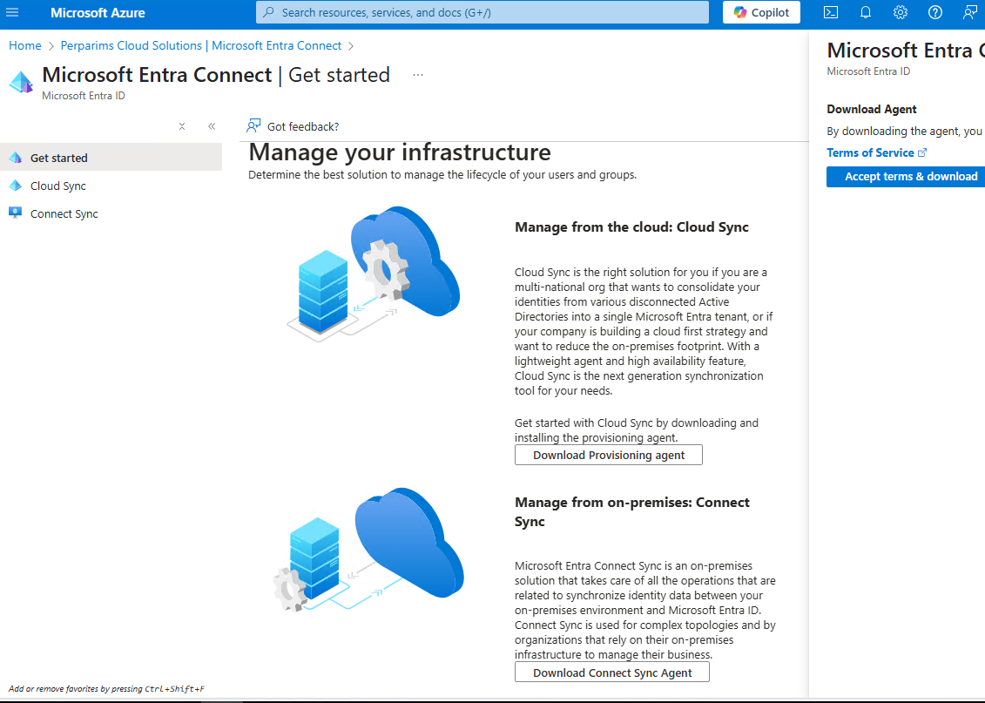
🛠 Step 1 – Download Connect Sync Agent
Started by downloading the Microsoft Entra Connect Sync Agent from the portal to enable hybrid identity sync.

Slide 3
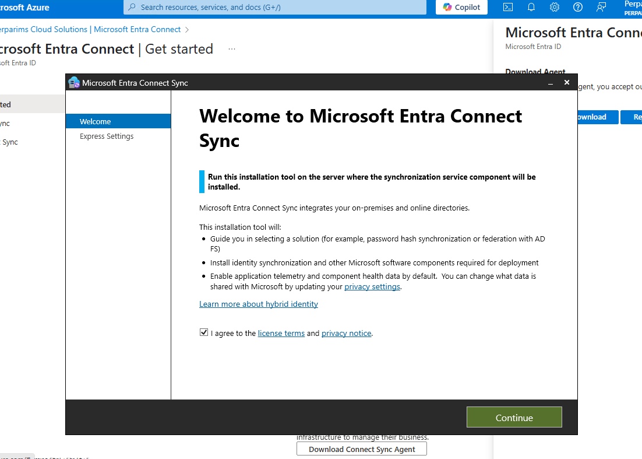
📥 Step 2 – Install & Launch Wizard
Installed the agent on the domain controller and launched the configuration wizard.

Slide 4
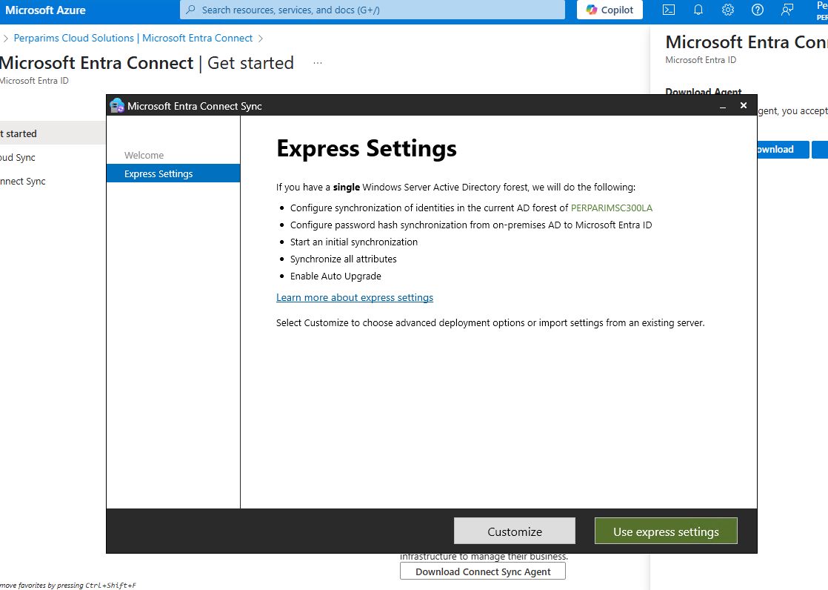
⚙️ Step 3 – Chose Express Settings
Since I had a single AD forest, I used Express Settings to simplify setup.

Slide 5
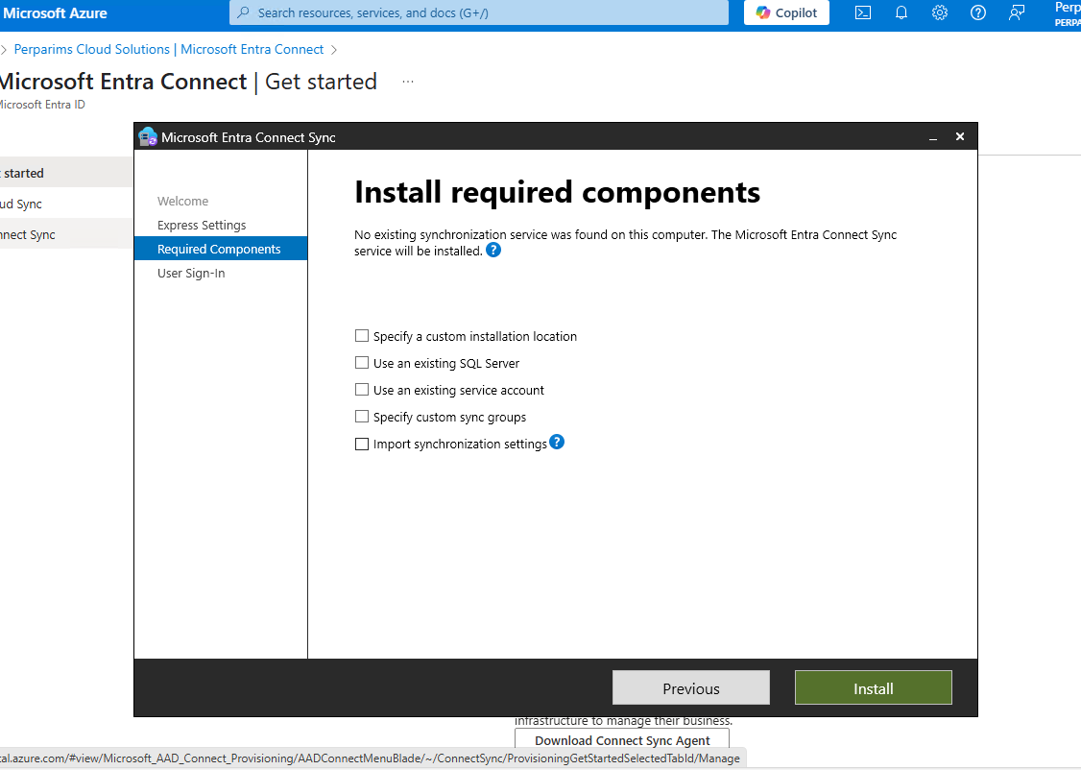
📦 Step 4 – Install Required Components
Let the wizard install the required sync engine and components.

Slide 6
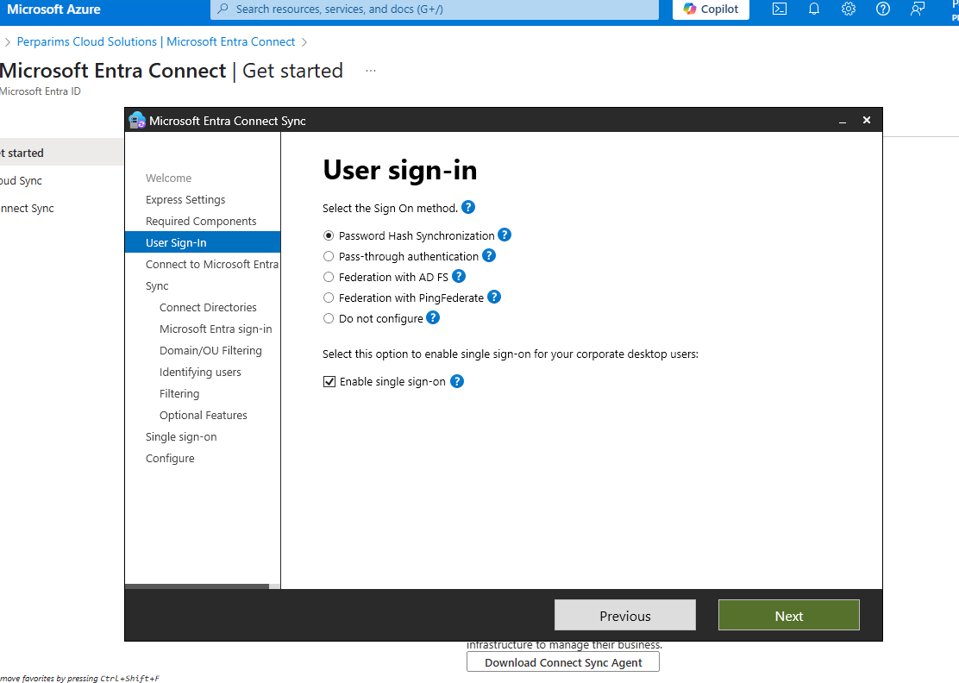
🔐 Step 5 – Choose Sign-In Method
Selected Password Hash Synchronization with Single Sign-On for user convenience.

Slide 7
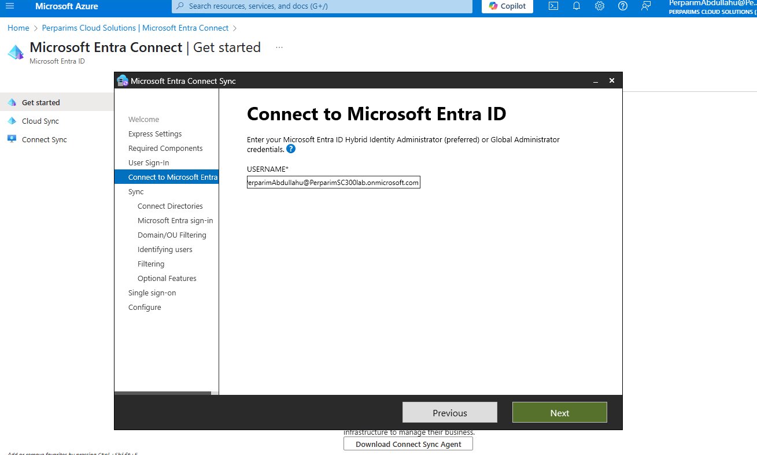
🌐 Step 6 – Connect to Entra ID
Entered my Global Administrator credentials to connect to Microsoft Entra ID.

Slide 8
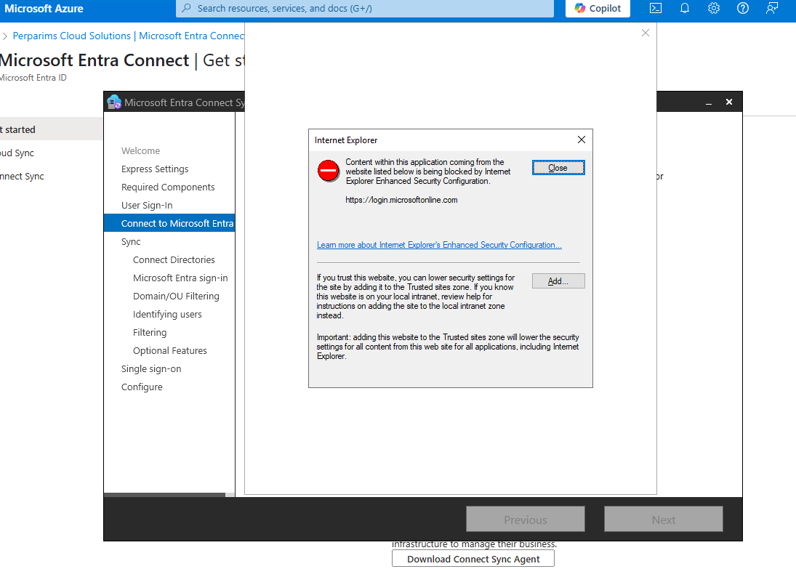
🚫 JavaScript Error (Resolved)
Faced a browser error due to IE Enhanced Security. Fixed it by adding Microsoft URLs to Trusted Sites.

Slide 9
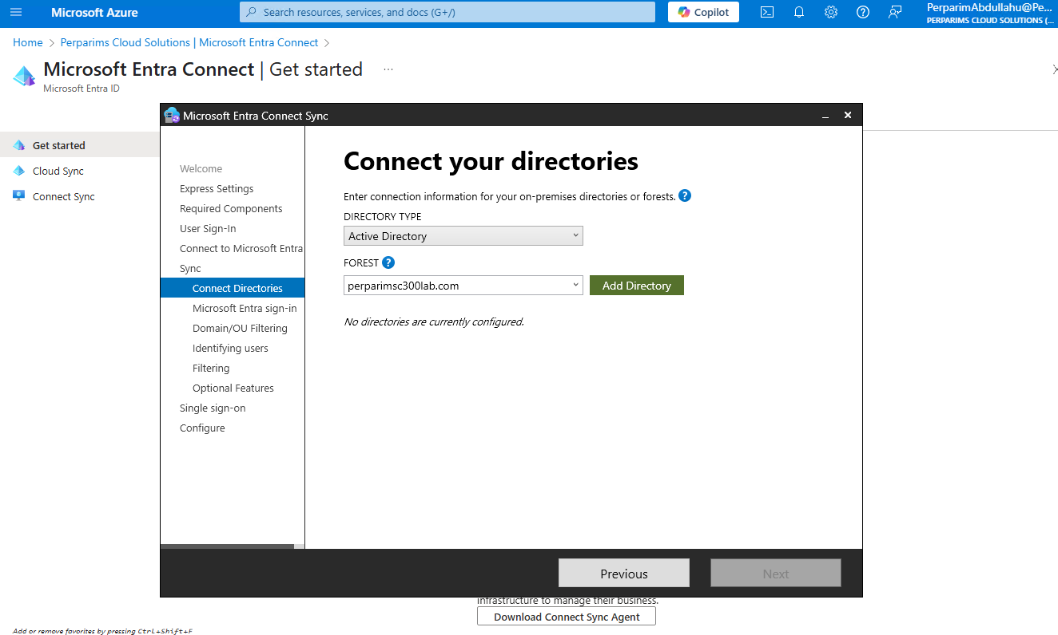
🌲 Step 7 – Connect Local AD Forest
Specified the AD forest and authenticated using Enterprise Admin credentials.

Slide 10
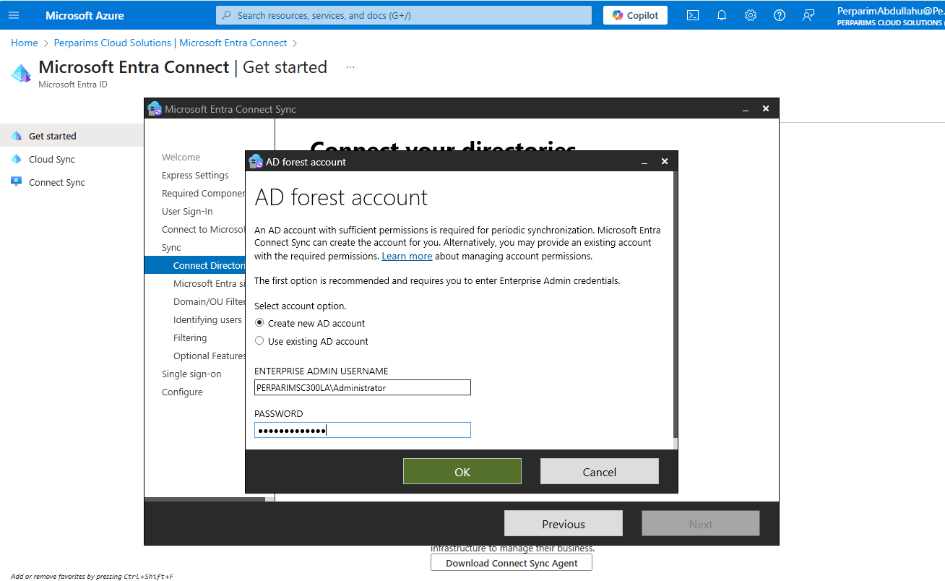
✅ Forest Connection Confirmed
Successfully connected to perparimsc300lab.com for sync.

Slide 11
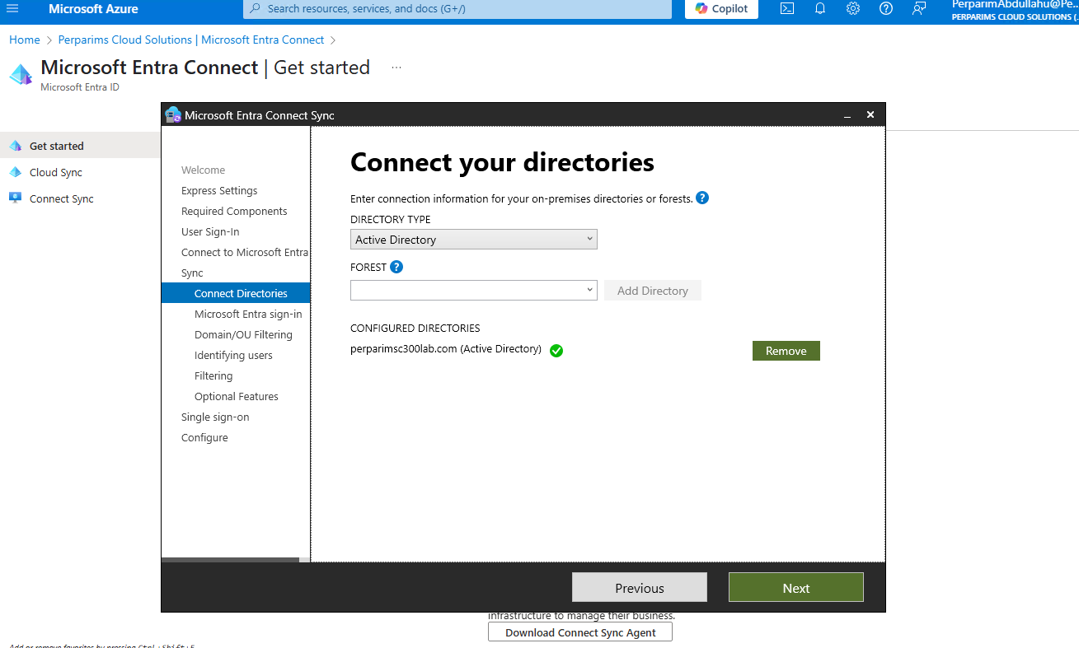
🔁 Step 8 – UPN Configuration
Notified that my custom UPN suffix wasn't verified. Continued with a warning for lab purposes.

Slide 12
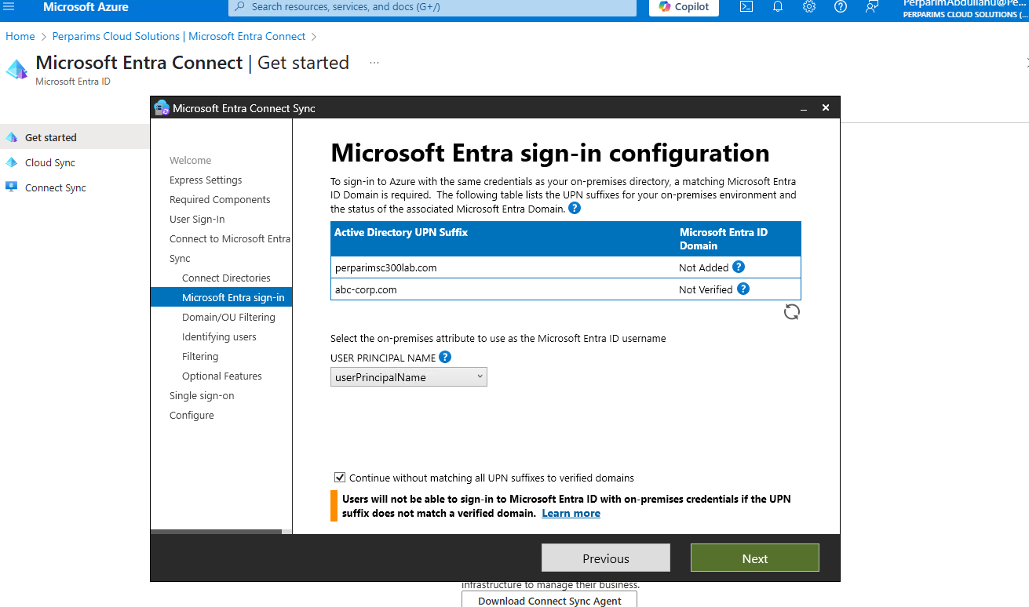
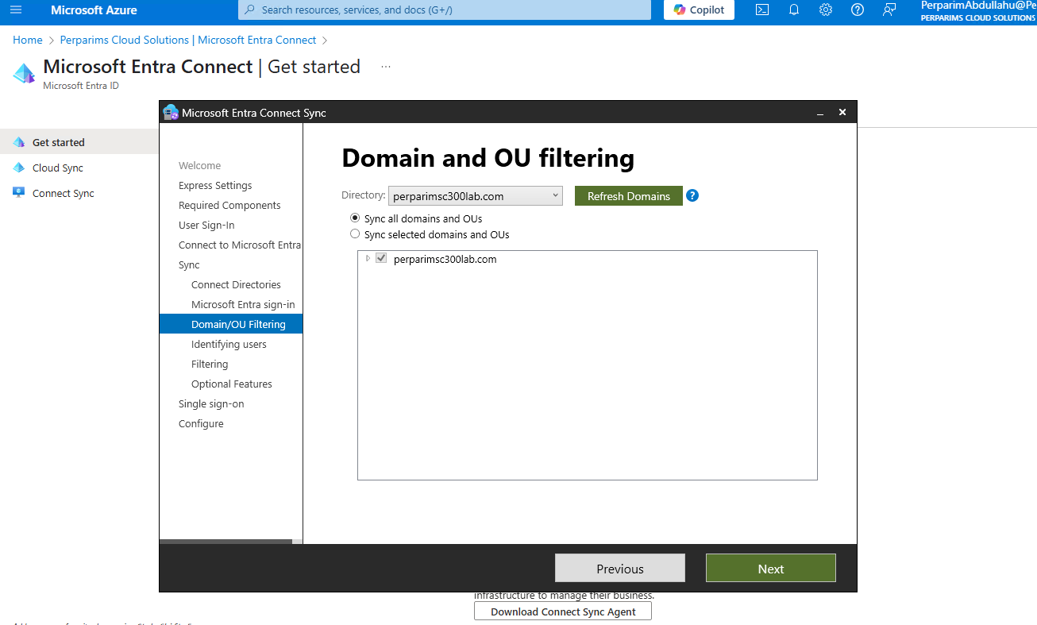
📂 Step 9 – OU Filtering Option
Filtered the synchronization scope by selecting only relevant OUs.

Slide 13
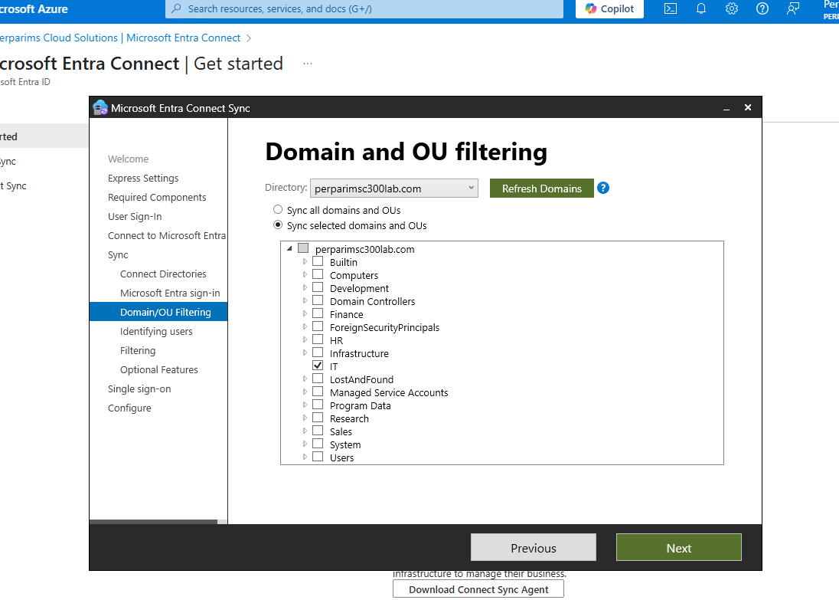
👥 Step 10 – Identify Users
Chose mail attribute for user matching and allowed Azure to manage the source anchor.

Slide 14
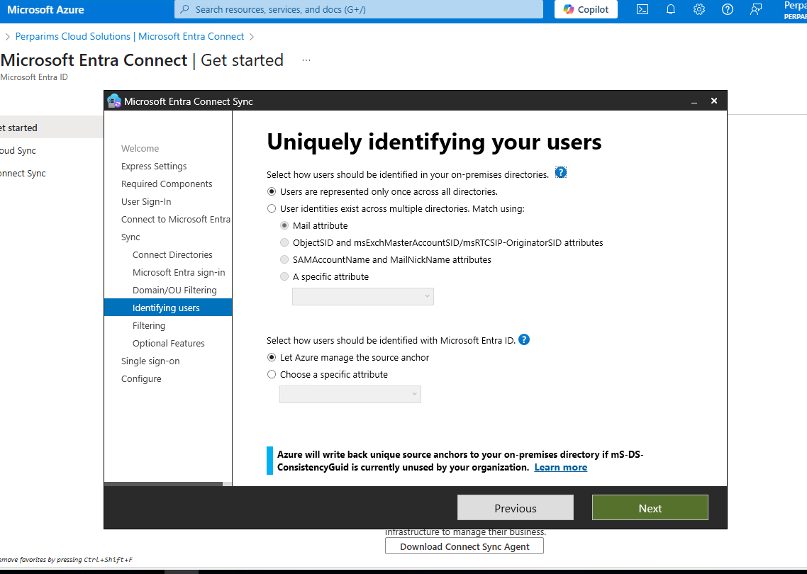
🔎 Step 11 – Filtering Users & Devices
Selected to sync all users and devices for the lab environment.

Slide 15
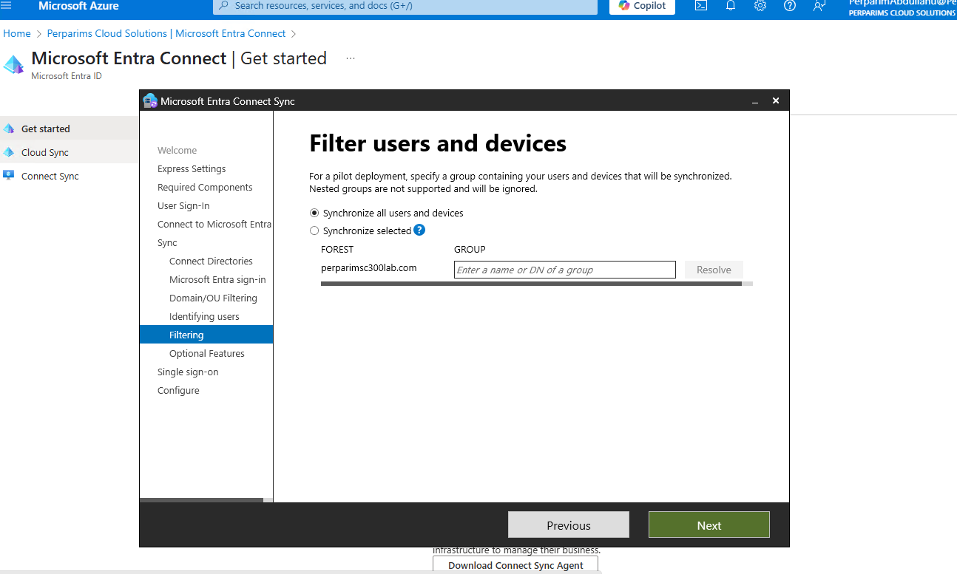
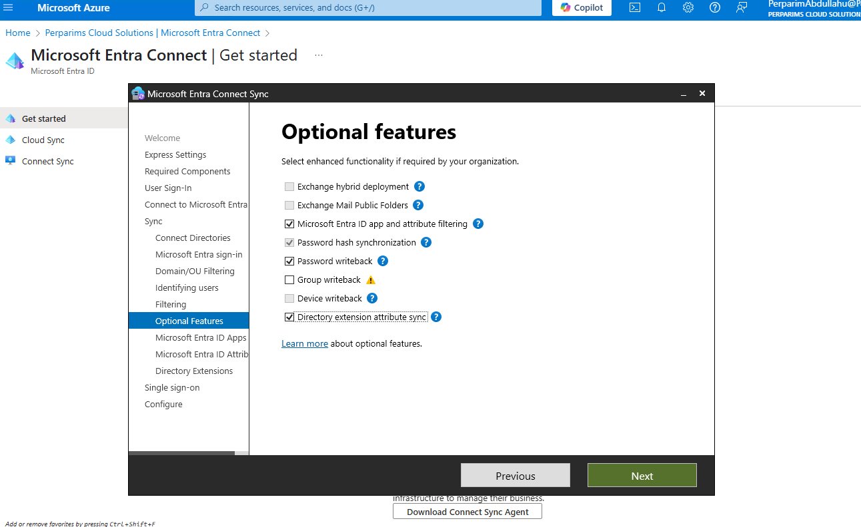
✨ Step 12 – Enable Optional Features
Enabled:
Microsoft Entra ID app filtering
Password hash sync
Password writeback
Directory extension attribute sync

Slide 16
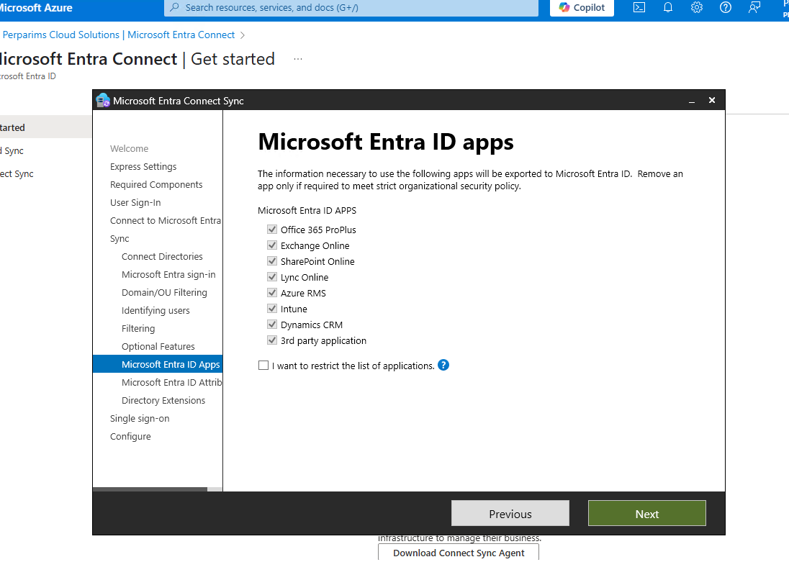
🧩 Step 13 – Select Apps
Selected key M365 apps for sync.

Slide 17
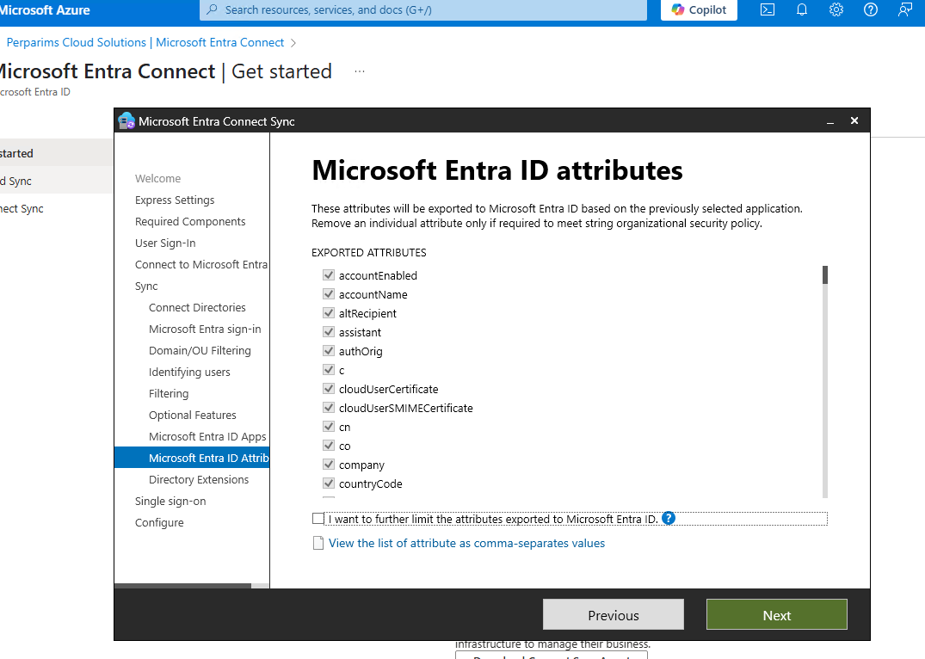
🧬 Step 14 – Attribute Sync Preview
Previewed the exported attributes to Microsoft Entra ID.

Slide 18
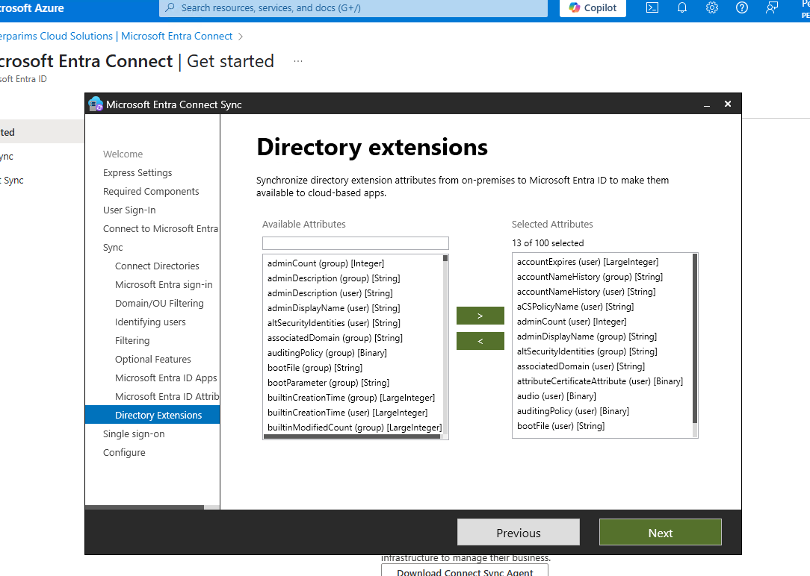
🔄 Step 15 – Directory Extensions
Selected extra attributes from AD to be available in Microsoft Entra for cloud-based apps.

Slide 19
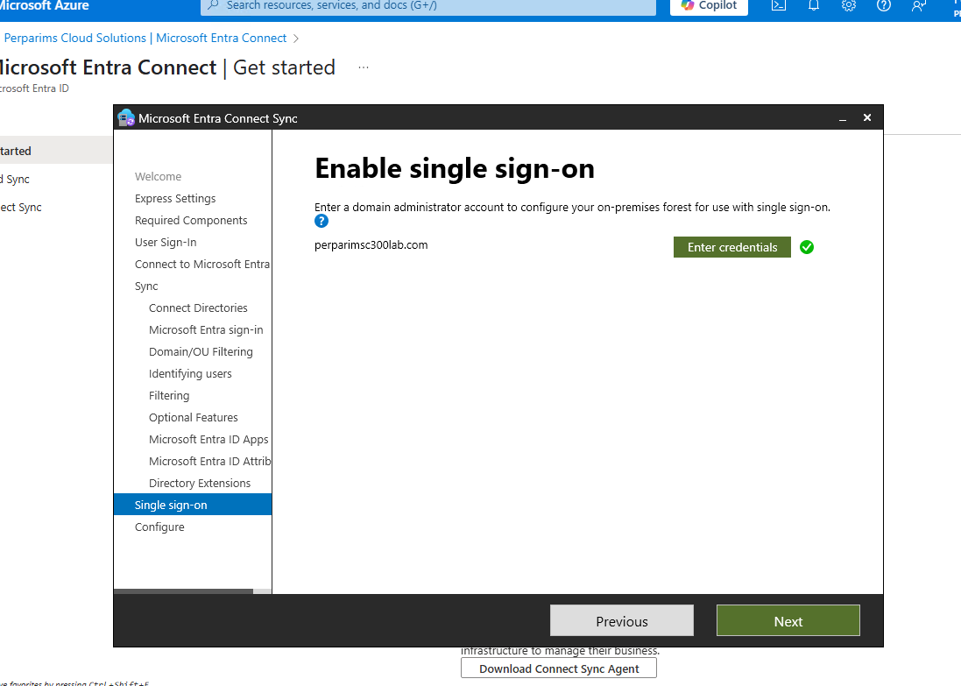
🔓 Step 16 – Enable Seamless SSO
Enabled seamless SSO by authenticating with domain credentials.

Slide 20
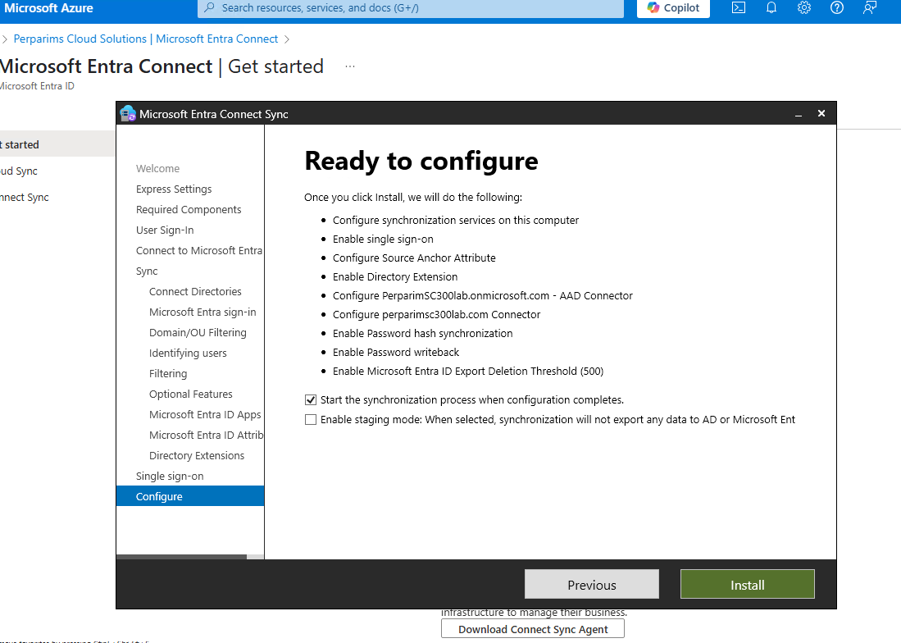
🚀 Step 17 – Start Sync Configuration
Let the wizard begin synchronization immediately after configuration completed.

Slide 21
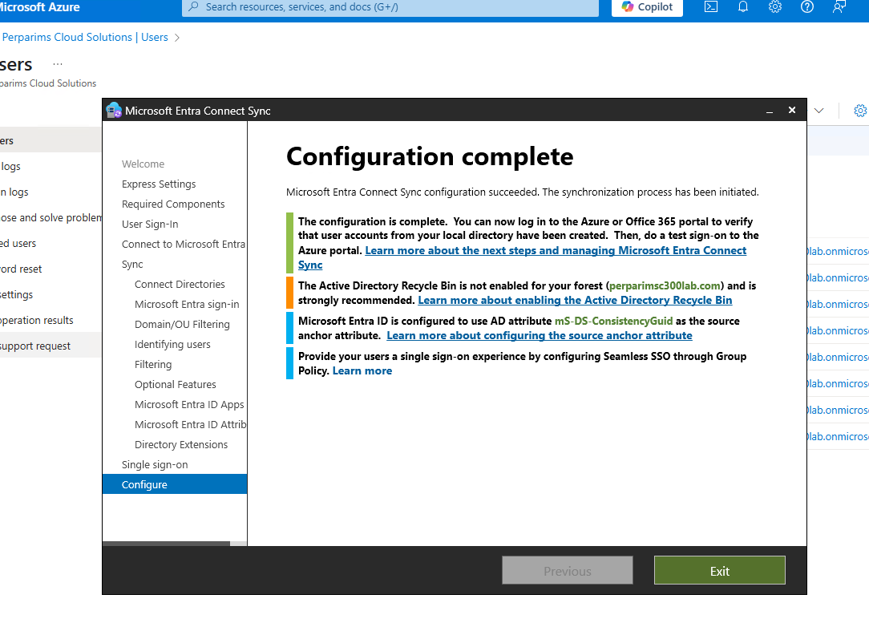
✅ Sync Configuration Complete
Wizard successfully finished. Microsoft Entra Connect Sync is now running and syncing users.

Slide 22
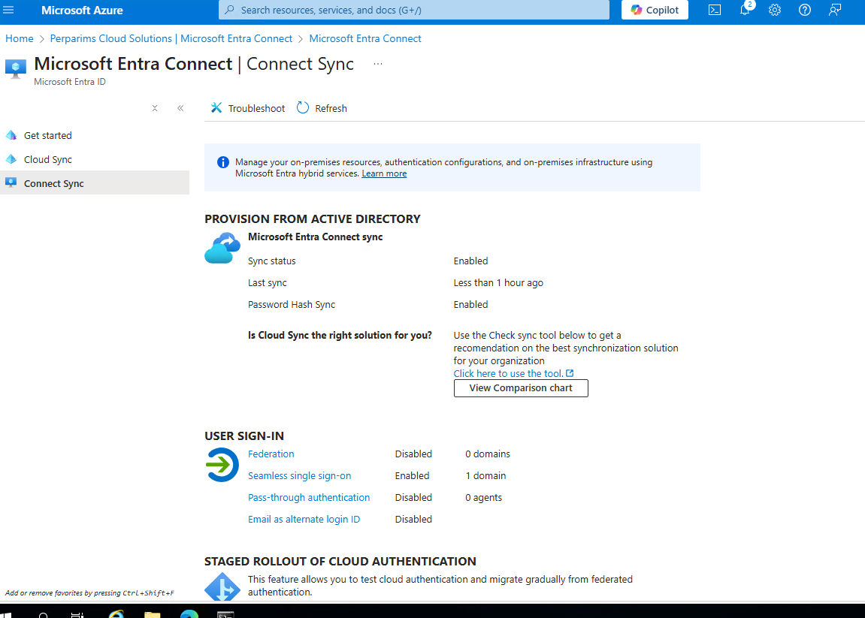
🔄 Portal Status Check
Confirmed sync status and password hash sync from the Microsoft Entra Admin Center.

Slide 23
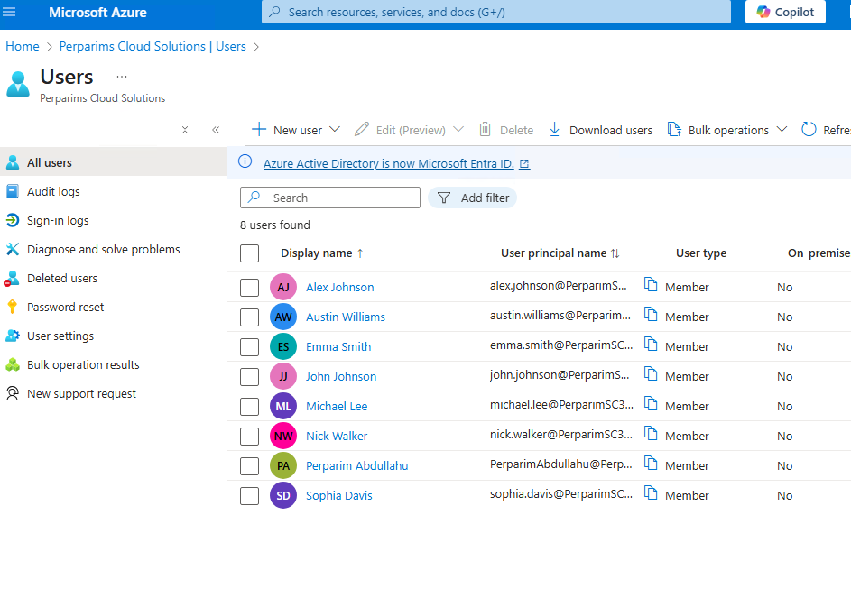
👤 User Sync Verification (Before)
Before sync – only cloud users existed in Microsoft Entra ID.

Slide 24
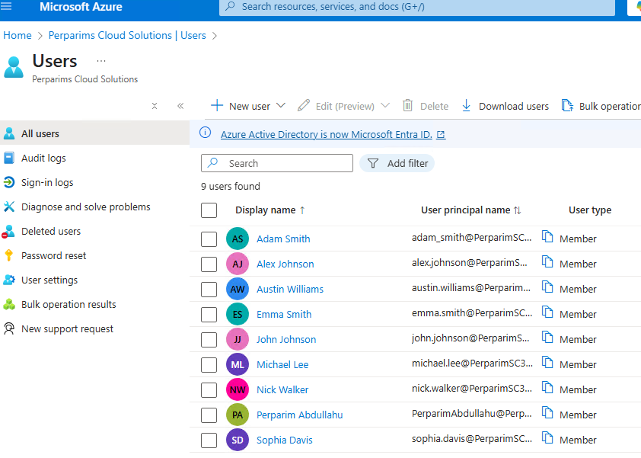
👥 User Sync Verification (After)
After sync – on-premises AD users appeared in Microsoft Entra ID.

Slide 25
🧠 Key Takeaways
Hybrid identity in action
Password Hash Sync & Seamless SSO
Real lab = real job-ready skills
✅ Next: Implement Conditional Access for synced users!

